Slide 1
REAL TIME POLLING SYSTEM
By,
Rajashekar Reddy Vemula
Koushik Reddy Sama
Sai Krishna Reddy Katta

Slide 2
Introduction
In this project we are providing a basic interface for public to vote for their favorite IPL player.
We have provided few top players list so that the user can vote only from

Slide 3
Introduction
An electronic polling system allows users cast their votes with ease without the trouble and stress of visiting a Polling booth.
This makes it easily accessible because it will be employed by users anywhere within the world.
Adding Realtime functionality to the applying improves the user experience as votes are seen in Realtime.

Slide 4
Topics To be discussed
The objective of the project
Inspiration from the existing project
How our project is different ?
Architecture
Individual contribution
Project demo
Issues
references

Slide 5
Objectives and details
The objective of the project:
- The main objective of our project is to find the favorite player of the
IPL (Indian premiere league) from the list of players given.
Inspiration from projects:
- It is basically inspired from taking a survey of people before the election.

Slide 6
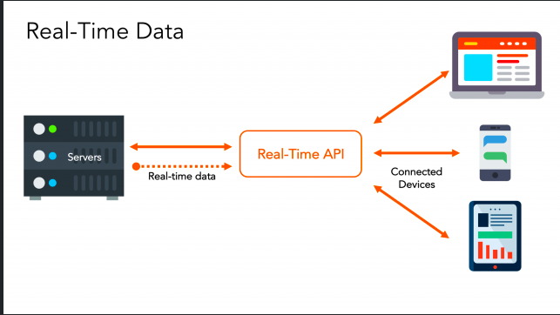
HOW YOUR PROJECT IS DIFFERENT? AND THE ARCHITECTURE
It is quite different from the general elections, here in our project people choose their favorite player from IPL through internet.
The main difference is the results of this poll will be displayed right after the poll ends, where in the general elections they take time to count the votes and announce the results.
Below is the architecture of our project

Slide 7
ISSUES AND REFERENCES
Issues:
Connection between server and host
Variables not defined
References
https://pusher.com/tutorials/
https://www.npmjs.com/package/pusher
https://www.freecodecamp.org/news/how-to-create-an-online-poll-with-asp-net-core-angular-5-and-highcharts-85ff7fecbaf1/

Slide 8


